Slide 1
ADA BOOSTING REGRESSOR
An AdaBoost regressor (meta estimator) is an ensemble method that combines multiple weak regression models (often decision trees) to improve predictive performance. Initially, a regressor is trained on the dataset, and subsequent regressors are trained on the same dataset but with adjusted weights, giving more focus to instances where the previous regressor made errors. This iterative process helps the model to correct mistakes and perform better on difficult cases.

Slide 2
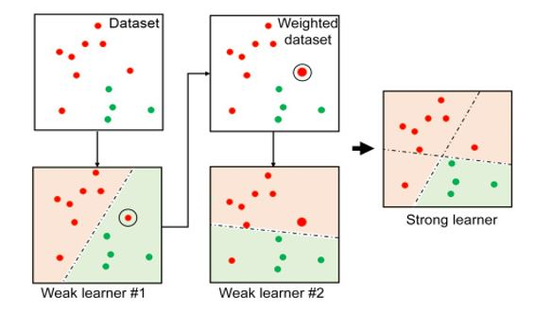
ADA Boost Example from sklearn.ensemble import AdaBoostRegressor regr = AdaBoostRegressor(random_state=0, n_estimators=100) regr.fit(X, y)

Slide 3
How ADABoost Works
Initialization:
Begin by assigning equal weights to all training examples.
Train Weak Learner:
Train a weak learner (e.g., decision stump) on the dataset. The learner will make predictions, and some of these predictions will be incorrect.
Calculate Error:
Compute the weighted error rate of the classifier. The error is the sum of the weights of the misclassified instances divided by the sum of all weights.
Update Weights:
Increase the weights of the misclassified instances, so that the next weak learner will focus more on these harder examples.
Decrease the weights of correctly classified instances, making them less important for the next classifier.
Repeat:
Repeat steps 2-4 for a fixed number of iterations or until no further improvements can be made.
Final Model:
The final model is a weighted combination of all the weak learners, where more accurate learners are given higher weights.

Slide 4
Common Use Cases of AdaBoost Regressor
Improving Performance on Small to Medium Datasets:
AdaBoost is often effective when you have a relatively small dataset or when individual regression models (e.g., linear models or shallow decision trees) fail to capture the complexity of the data. By combining multiple weak models, AdaBoost can lead to better performance than individual models.
Handling Non-linear Data:
AdaBoost is powerful when the data contains non-linear relationships that simple models might miss. For example, when the relationship between features and the target variable is non-linear, AdaBoost can adapt by assigning higher weights to difficult-to-predict instances, improving the model's accuracy over time.
Modeling Complex Data Distributions:
AdaBoost can help capture complex patterns in the data, such as varying levels of noise or outliers, by focusing more on hard-to-predict cases. The process of adjusting weights gives it the ability to refine predictions and better fit complex data distributions.

Slide 5
Improving Weak Regressors:
In cases where you have weak base learners, such as a decision stump (a shallow decision tree with just one split), AdaBoost can significantly improve their performance by combining them into a stronger ensemble. This is useful when base learners by themselves have low predictive power
Regression Tasks in Business and Economics:
AdaBoost is applied in forecasting, pricing models, demand prediction, and risk assessment, where you need a robust model that can adapt to a variety of scenarios and provide accurate continuous predictions.
Real-world Examples:
Financial Forecasting: Predicting stock prices, interest rates, or credit scores, where the underlying patterns are often complex and noisy.
Medical Predictions: Estimating continuous outcomes, such as predicting the progression of a disease or the effectiveness of a treatment, where medical data might include varying levels of noise and missing values.
Energy Demand Prediction: Predicting electricity consumption or renewable energy generation, where multiple factors affect the output in a non-linear manner.

Slide 6
Advantages of Using AdaBoost Regressor
Increased Accuracy:
By combining multiple weak regressors, AdaBoost usually results in a more accurate and robust model compared to individual regressors.
Focus on Hard-to-Predict Instances:
AdaBoost automatically adjusts to focus more on the instances that are difficult for previous models, thus improving prediction for those challenging cases.
Reduced Overfitting:
While boosting methods, in general, can be prone to overfitting, AdaBoost tends to handle overfitting better than some other algorithms by adjusting weights in a controlled manner, especially if you use a simple base model.
Works Well with Simple Models:
AdaBoost works well even when using simple regressors like decision stumps or shallow decision trees. This is beneficial when you want a fast and efficient model.
No Feature Scaling Required:
AdaBoost does not require feature scaling (e.g., normalization or standardization) to work effectively, which can save preprocessing time.

Slide 7
Disadvantages of Using AdaBoost Regressor
Sensitive to Noisy Data:
AdaBoost can be overly sensitive to noise and outliers in the data, especially when the number of iterations is large. Outliers or mislabelled data points can dominate the model and reduce overall performance.
Computationally Intensive:
Since AdaBoost involves training multiple weak models in an iterative manner, it can be computationally expensive and time-consuming, particularly for large datasets.
Risk of Overfitting:
If the model is trained for too many iterations, AdaBoost may start to overfit to the training data, especially if the dataset is small or noisy. This is why hyperparameter tuning (like limiting the number of estimators or using early stopping) is important.
Base Learner Limitations:
While AdaBoost can improve weak learners, it is limited by the performance of the base regressor. If the base regressor is too weak (e.g., a very shallow decision tree), the model's overall performance may still be suboptimal, even with boosting.

Slide 8
XG Boosting Regressor
XGBoost (Extreme Gradient Boosting) is an optimized, efficient, and scalable version of the gradient boosting algorithm. It is widely used for machine learning tasks, particularly for regression and classification problems, due to its high performance and speed. XG Boost is a type of boosting algorithm that combines the predictions of multiple weak learners (typically decision trees) to form a strong prediction.
XGBoost is highly effective for both structured (tabular) data and datasets with many features, and it can be used for both regression and classification tasks.

Slide 9
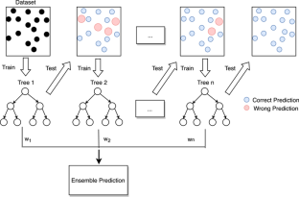
XG BOOSTER EXAMPLE
from sklearn.ensemble import GradientBoostingRegressor
regressor=GradientBoostingRegressor(loss='absolute_error',
learning_rate=0.1,n_estimators=300, max_depth = 1,max_features = 5)

Slide 10
How XG BOOST WORKS
XGBoost builds trees sequentially, where each tree tries to correct the errors made by the previous tree. The steps involved are:
Initialization: Start with a simple model, often predicting the mean of the target variable for all samples (in regression).
Tree Construction: For each subsequent tree, calculate the residual errors (the difference between the actual and predicted values) from the previous model and use them as the target for the new tree.
Gradient Descent: The algorithm uses gradient descent to minimize the loss function by adjusting the parameters (weights) of the model.
Regularization: XGBoost applies regularization (L1 and L2) to penalize large model coefficients, helping to prevent overfitting.
Boosting: The model is boosted (updated) iteratively by adding trees, each learning from the residuals of the previous trees.
The final prediction is a weighted combination of the predictions from all the trees.

Slide 11
Common uses of the XGBoost Regressor
XGBoost is a powerful algorithm that is widely used in various domains for regression tasks. Its versatility, high accuracy, speed, and ability to handle large and complex datasets make it ideal for:
Predicting continuous target variables
Time series forecasting
Risk and financial analysis
Customer behavior prediction
Supply chain and resource management
Marketing optimization
By applying XGBoost in these areas, organizations can make more informed decisions, improve predictions, and achieve better overall performance.

Slide 12
Advantages of XGBoost Regressor
High Accuracy:
XGBoost often performs very well and is competitive on a wide variety of datasets. It has won many machine learning competitions, making it a go-to choice for many regression and classification problems.
Efficiency and Speed:
XGBoost is highly optimized for both training speed and predictive power. It uses parallel and distributed computation, which makes it much faster than other boosting algorithms like traditional gradient boosting.
Regularization:
XGBoost includes L1 and L2 regularization, helping to prevent overfitting by penalizing overly complex models.
Handling Missing Data:
XGBoost can handle missing values natively without the need for imputation, as it learns how to handle missing values during training.
.

Slide 13
Flexibility:
XGBoost can handle both classification and regression tasks, as well as custom loss functions. It can work with different types of base learners (e.g., decision trees, linear models).
Robustness to Overfitting:
The model is less likely to overfit compared to other algorithms, thanks to the built-in regularization and feature selection.
Support for Parallel and Distributed Computing:
XGBoost is designed to efficiently scale with larger datasets, utilizing parallel processing and GPU acceleration.
Feature Importance:
XGBoost provides feature importance scores, which can help you understand which features are most impactful for your model’s predictions

Slide 14
Disadvantages of XGBoost Regressor
Complexity:
XGBoost has many hyperparameters to tune (e.g., n_estimators, max_depth, learning_rate, subsample), which can make it harder to set up correctly. It requires expertise in tuning these parameters to achieve optimal results.
Sensitivity to Noisy Data:
While XGBoost can handle noisy data better than some algorithms, it can still be sensitive to outliers and noisy data, especially when overfitting occurs.
Long Training Time for Large Datasets:
XGBoost can be computationally expensive when dealing with very large datasets, and while it supports parallelism, the training process can still take a long time.
Black Box:
XGBoost, like many ensemble methods, is often considered a "black box," meaning that it’s harder to interpret the model compared to simpler models like linear regression. While feature importance can be examined, the relationships learned by the trees are not as easily understood.

Slide 15
5.Memory Usage:
XGBoost can be memory-intensive, especially when working with very large datasets and deep trees.
Overfitting with Many Trees:
XGBoost can still overfit if too many trees are used without sufficient regularization, especially when the dataset is small or the model is overly complex.
XGBoost is one of the most powerful and popular algorithms for regression tasks due to its efficiency, flexibility, and performance. It’s widely used in machine learning competitions and real-world applications for tasks such as forecasting, pricing, and risk prediction. While it’s highly effective, it requires careful tuning of hyperparameters and can be sensitive to noisy data, overfitting, and large datasets. If computational cost and interpretability are less of a concern, and you’re looking for top-notch performance, XGBoost is an excellent choice.

Slide 16
LightGBM (Light Gradient Boosting Machine)
LightGBM (Light Gradient Boosting Machine) is a highly efficient, scalable, and fast implementation of the gradient boosting algorithm. It was developed by Microsoft and is optimized for performance, particularly on large datasets. LightGBM is similar to other boosting methods, such as XGBoost, but has several improvements that make it more efficient and effective, especially when dealing with large datasets.
LightGBM is used for both classification and regression tasks and can handle large-scale data with high-dimensional features. It’s also known for its speed, low memory usage, and high accuracy.

Slide 17
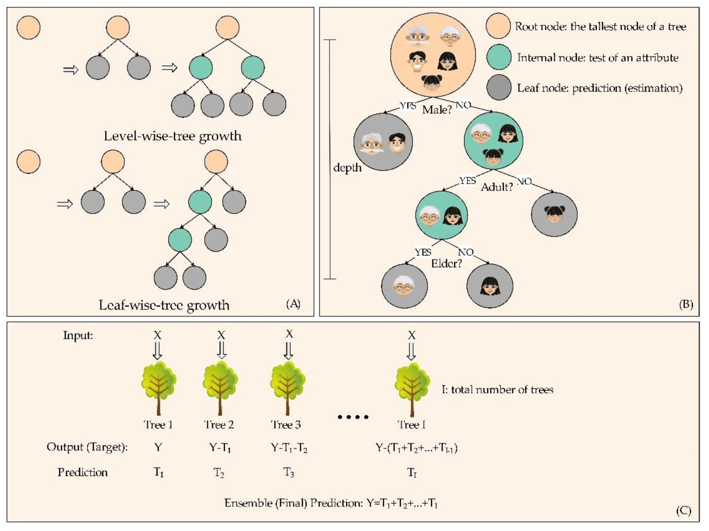
Example of LGBMRegressor
from lightgbm import LGBMRegressor
regressor=LGBMRegressor( boosting_type='gbdt', max_depth=-1,
learning_rate=0.05, n_estimators=100, num_leaves=31 )

Slide 18
How LightGBM Works
Initialization: Start with an initial model (usually the mean or median for regression) and calculate residuals (errors).
Train Decision Trees: Construct decision trees using a leaf-wise growth strategy. This means LightGBM splits leaves rather than levels, allowing it to grow deeper trees that focus on the more difficult data points.
Objective Function: LightGBM minimizes a loss function (such as mean squared error for regression tasks) using gradient descent.
Boosting Process: Trees are added sequentially, and each tree attempts to correct the mistakes of the previous ones, just like in other boosting methods.
The final prediction is the sum of the predictions from all trees, with each tree’s contribution weighted according to the learning rate.

Slide 19
Common uses of LightGBM Regressor
LightGBM - Its efficiency, scalability, and ability to handle large datasets with high-dimensional features make it particularly effective in various domains. Below are some common uses of LightGBM Regressor in real-world applications:
Predicting Continuous Target Variables (Regression Tasks)
Time Series Forecasting
3. Customer Lifetime Value (CLV) Prediction
4. Credit Risk and Loan Default Prediction
5. Healthcare Predictions
6. Energy Efficiency and Renewable Energy Prediction
Supply Chain Optimization
8. Marketing Analytics and A/B Testing
Anomaly Detection
10. Manufacturing and Predictive Maintenance

Slide 20
Advantages of LightGBM Regressor
High Speed and Efficiency:
LightGBM is highly optimized for speed. It can handle large datasets efficiently with low memory usage due to its use of techniques like Gradient-based One-Side Sampling (GOSS) and Exclusive Feature Bundling (EFB).
Scalability:
It can scale to large datasets with high-dimensional features, and it performs well in both small and large-scale machine learning tasks.
High Accuracy:
LightGBM typically provides higher accuracy than other gradient boosting algorithms due to its use of leaf-wise tree growth, which can capture more complex patterns.

Slide 21
Efficient Handling of Categorical Features:
LightGBM can handle categorical features directly without the need for one-hot encoding, which can save computational resources.
Regularization:
LightGBM includes built-in regularization, which helps reduce overfitting and makes the model more robust to noise and outliers.
Parallel and GPU Support:
LightGBM can be run in parallel and supports GPU training, further increasing speed for large datasets.
Less Memory Usage:
Compared to other implementations like XGBoost, LightGBM uses less memory, making it suitable for resource-constrained environments.

Slide 22
Disadvantages of LightGBM Regressor
1.Overfitting in Small Datasets:
While LightGBM works well on large datasets, its leaf-wise tree growth can lead to overfitting if the dataset is small. Proper regularization and tuning are required to mitigate this.
Hyperparameter Tuning:
LightGBM has several hyperparameters to tune, and finding the optimal settings can be time-consuming. It requires expertise to fine-tune parameters like num_leaves, learning_rate, and max_depth to avoid overfitting.
Interpretability:
Like other tree-based methods, LightGBM models are often considered "black boxes," meaning that they are less interpretable than linear models or simpler algorithms like decision trees.

Slide 23
Sensitive to Noisy Data:
LightGBM, like other boosting methods, can be sensitive to noisy data and outliers, especially when the model complexity is high. Careful data preprocessing and feature engineering are necessary.
Memory Consumption for Large Trees:
If the num_leaves parameter is set too high, or if too many trees are grown, LightGBM can consume significant memory. It’s important to balance model complexity and memory usage.
Non-Deterministic Results:
LightGBM can produce slightly non-deterministic results due to its parallel processing, especially with the use of multi-threading or GPU training.
LightGBM is a powerful and efficient gradient boosting algorithm that performs well on large datasets and high-dimensional data. It offers advantages like faster training time, lower memory usage, and higher accuracy, making it an excellent choice for machine learning tasks, especially in competitive environments. However, like all powerful algorithms, it requires careful tuning and is prone to overfitting on small datasets.

